Slide 1

Moderation in Multilevel Models in R
Psych 741: Hierarchical Linear Modeling

Slide 2
Overview of Tutorial Slides
Centering variables (pages 3-8)
Interaction Effects in Multilevel Models
Overview of tutorial data (page 10)
Example Models, Code, and Output (pages 11-17)
Plotting interaction effects (pages 18-23)
Simple slope analysis (pages 24-26)

Slide 3
Centering Variables

Slide 4
Tutorial Data
Using the Nurses.sav data file on Canvas
Sample of individual nurses nested in hospitals
The following variables are included in the data set:
hospital: hospital ID
nurse: nurse ID
age: nurse age (in years)
gender: nurse gender (0 = male, 1 = female)
experien: nurse experience in years
stress: nurse stress score (1 to 7)
wardtype: type of ward (0 = general care, 1 = special care)
hospsize: hospital size (0 = small, 1 = medium, 2 = large)

Slide 5
Grand-Mean Centering
A lot of ways to grand-mean center Level 1 and Level 2 variables
You simply need to subtract the overall mean of the variable from the Level 1 or Level 2 variable
Be careful with any missing data for the mean() function and any issues with the model sample differing from the larger data set the data may derive from.

Slide 6
Group-Mean Centering
Can also be done many ways, but one easy way is to create the group/cluster aggregate of the variable first and then use that variable to calculate the difference between each score and their respective group/cluster mean.

Slide 7
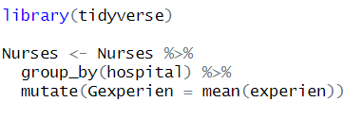
Aggregate Variables in R (Recap)
In this example, we group by hospital ID and estimate the mean individual experience
We also mutate a column in the original data frame to contain this Level-2 average nurse experience

Slide 8
Group-Mean Centering
Once the group aggregate variable has been created in the data frame, the group-mean centered variable can be estimated by taking the difference of the individual score and the group mean variable

Slide 9
Interaction Effects in Multilevel Models

Slide 10
Overview of Tutorial Data
Will continue to use the Nurses.sav data file to test various interaction effects across different levels (i.e., Level 1 and Level 2) and different types of variables (i.e., continuous, categorical)
Will not use centered variables in these examples for illustrative reasons, but centering would be based on theory and/or assumptions concerns

Slide 11
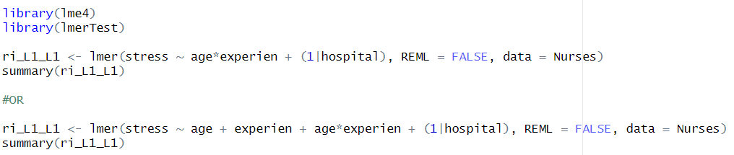
Example Model and Code (Two Level 1 Variables)
Similar to the random intercept models from previous weeks, but with an interaction term included between Level 1 fixed effects predictors.

Slide 12
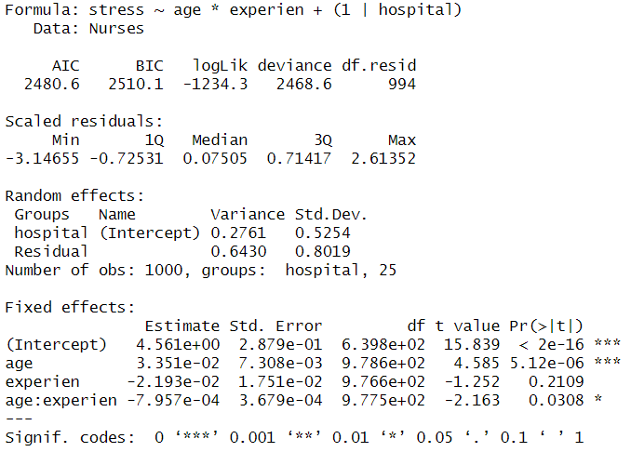
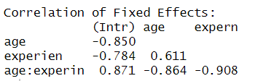
Example Output

Slide 13
Example Model and Code (Cross-Level Interactions)
Similar to the previous model, but with an interaction term between a Level 1 and Level 2 fixed effect predictor (whether the Level 2 variable is an aggregate of Level 1 scores or not).

Slide 14
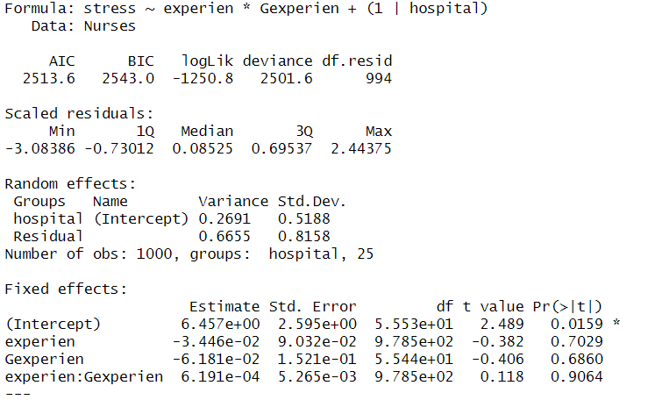
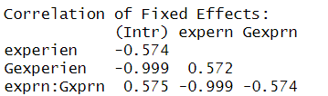
Example Output

Slide 15
Example Model and Code (w/ factor term)
Similar to the previous model, but with factor variable(s) included in the interaction term.

Slide 16
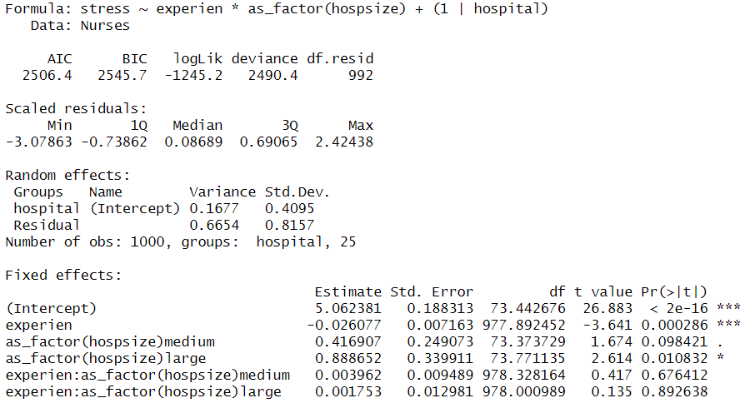
Example Output

Slide 17
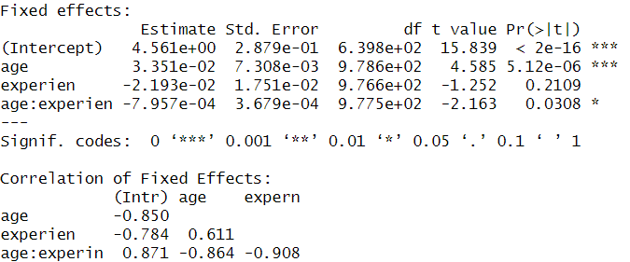
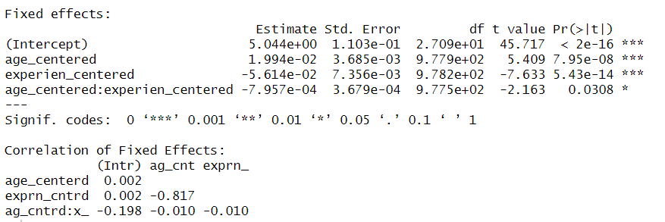

Centered vs. Non-Centered Predictors
Non-Centered
Grand-Mean Centered

Slide 18
Plotting Interactions
The package “interactions” handles plotting regression interactions (including lmer() models).
install.packages("interactions", dep = TRUE)
library(interactions)
For online tutorial:
https://cran.r-project.org/web/packages/interactions/vignettes/interactions.html

Slide 19
Plotting Interactions
After running a regression model that includes an interaction term, run the following code:
interact_plot(modelName, pred = IV, modx = moderator)
Example:

Slide 20
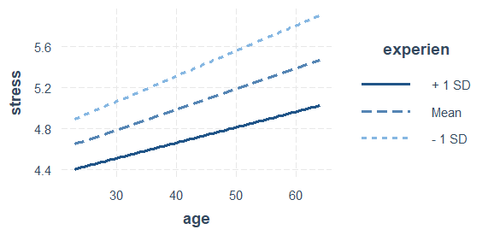
Example Figure

Slide 21
Adding Confidence Bands
Code:
interact_plot(modelName, pred = IV, modx = moderator, interval = TRUE, int.width = VALUE)
Example:

Slide 22
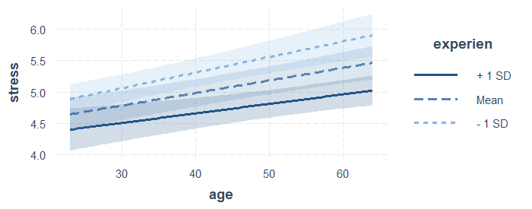
Example Figure

Slide 23
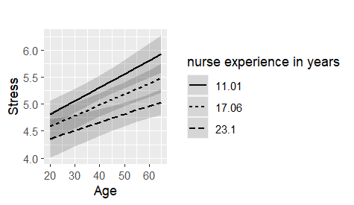
Other Plotting Functions
The plot_model() function from the sjPlot library can handle lme4 mixed-effects models too.

Slide 24
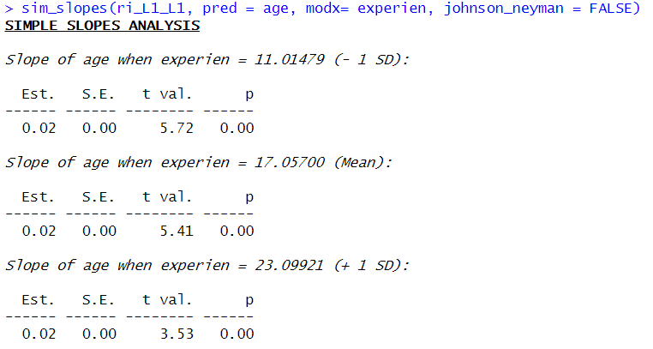
Simple Slope Analysis
After running a regression model that includes an interaction term, run the following code using the interactions package:
sim_slopes(modelName, pred = IV, modx = moderator)
If you don’t want the Johnson Neyman results to print out, you can set it to false.

Slide 25
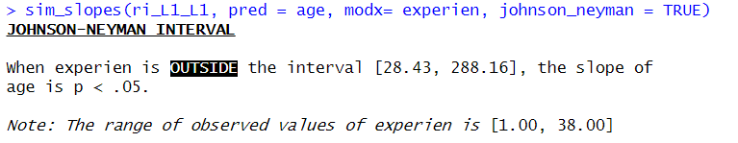
Simple Slope Analysis – Johnson Neyman

Slide 26
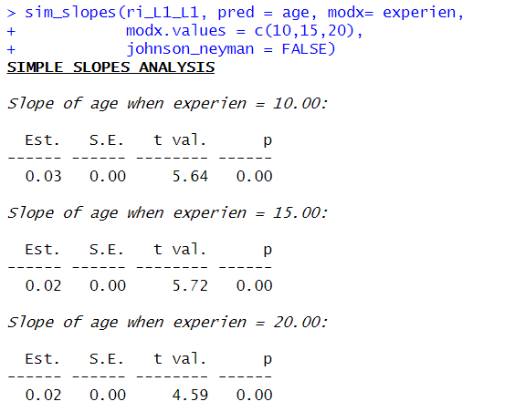
Simple Slope Analysis
If you want to specify the exact values on the moderator to test the simple slopes:
sim_slopes(modelName, pred = IV, modx = moderator, modx.values = c(value1, value2, …))
Example:

